Slide 1
Smart Farming agent
CAPSTONE PROJECT
Presented By: Zeeya Ul Haq
Faculty name : Aswini Kumar Sir
College Name & Department : Presidency University (Computer Science and Engineering)

Slide 2
OUTLINE
Problem Statement
Technology used
Wow factor
End users
Result
Conclusion
Git-hub Link
Future scope
IBM Certifications

Slide 3
Problem Statement
Modern farming struggles with labor shortages, inefficient resource use, and limited real-time decision-making. Traditional systems often rely on manual input and cannot adapt quickly to changing environmental conditions, leading to reduced productivity and higher costs.
Proposed Solution:
Farming Agentic AI is an autonomous system that uses sensor data, drone imagery, and AI reasoning to monitor crops, make decisions, and control farm machinery. It acts independently, sets farming goals, and adapts in real time to improve yield, efficiency, and sustainability.

Slide 4
Technology used
IBM watsonx.ai Studio
Natural Language Processing (NLP)
Retrieval Augmented Generation (RAG)
IBM Granite Foundation Model (LLM)
IBM Cloud Object Storage

Slide 5
IBM cloud services used
IBM Cloud Watsonx AI Studio
IBM Cloud Watsonx AI runtime
IBM Cloud Agent Lab
IBM Granite foundation model

Slide 6
Wow factors
This AI Agent delivers real-time, localized farming advice by combining advanced retrieval technology with trusted data sources. It supports natural language queries in local languages, making smart farming knowledge accessible to small-scale farmers. By providing timely, personalized guidance on weather, soil, pests, and market prices, it helps farmers make better decisions that boost yield and income.
Unique features:
Integrates diverse data sources: weather forecasts, soil reports, pest control info, crop recommendations, and current market prices
Conversational AI capable of understanding and responding to natural language queries in multiple local languages.
Dynamic retrieval system that fetches the most relevant and up-to-date information before generating advice.
Designed specifically for small-scale farmers, focusing on practical, actionable guidance.

Slide 7
End users
Small-scale farmers
Agriculture extension workers
Agri-tech startups
Farmer cooperatives
Government agencies

Slide 8
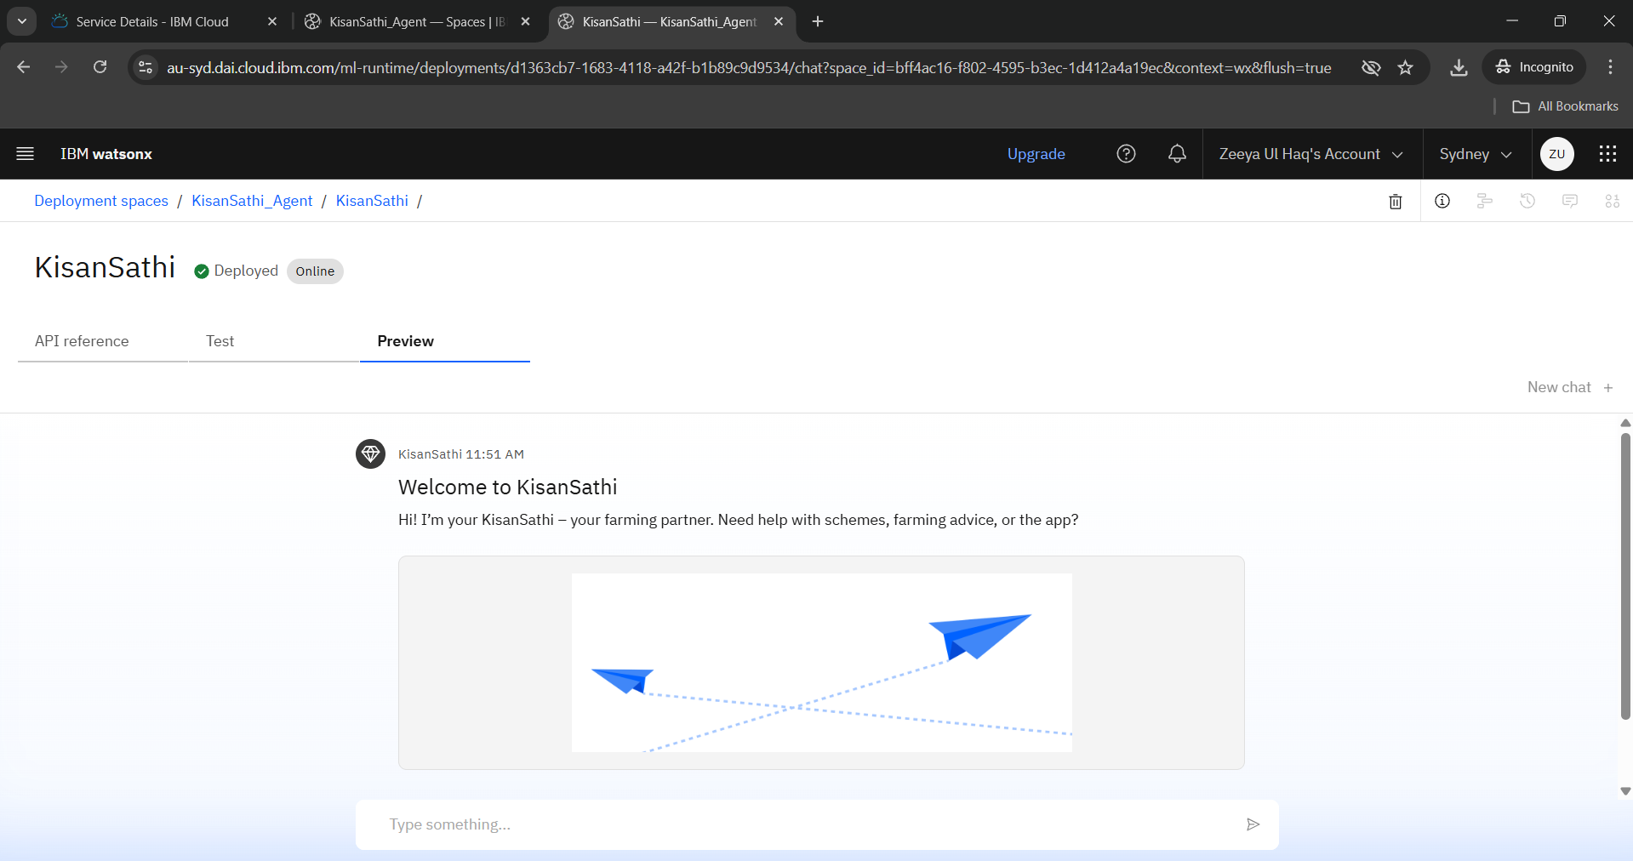
Results

Slide 9
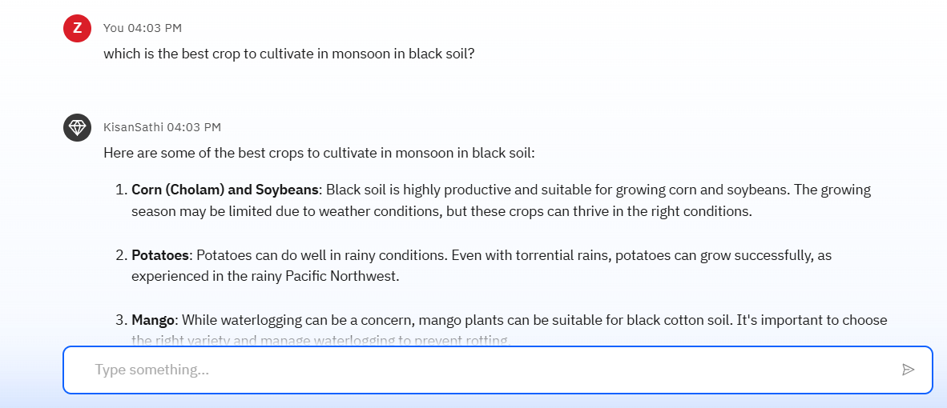
Results

Slide 10
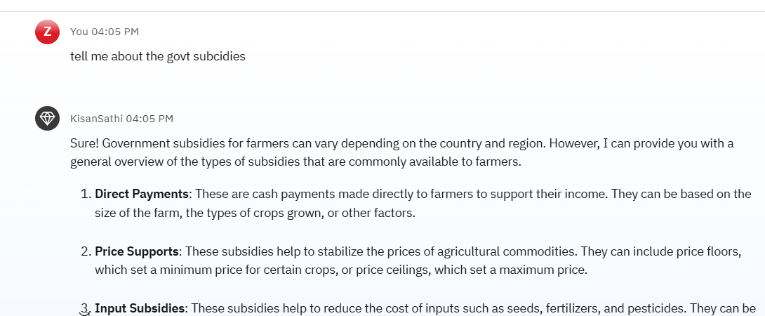
Results

Slide 11
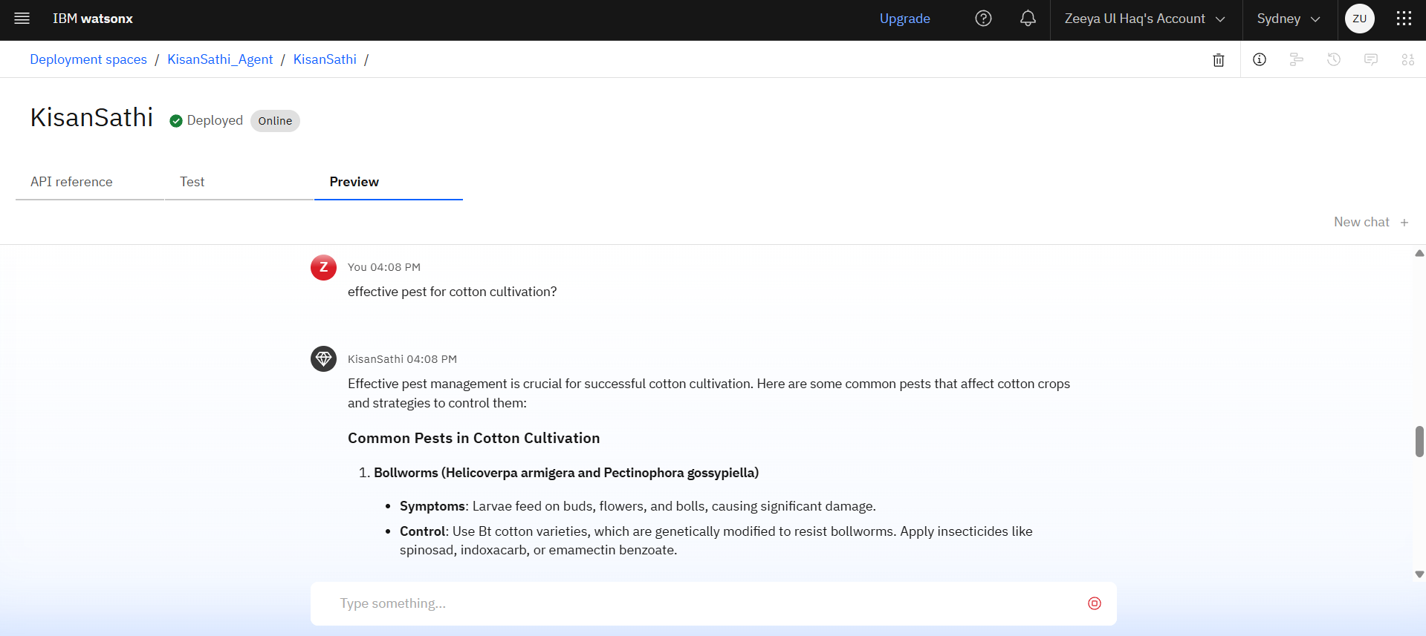
Results
Deployed AI Agent

Slide 12
Conclusion
Empowers small-scale farmers by providing real-time, localized agricultural advice tailored to their region and farming needs.
Utilizes Retrieval-Augmented Generation (RAG) to fetch accurate and up-to-date information from reliable sources like meteorological data, agricultural departments, and market databases.
Offers comprehensive insights on weather conditions, soil health, suitable crops for the season, pest control strategies, and current mandi (market) prices.

Slide 13
Future scope
Add IoT integration for real-time farm data.
Support more local languages and voice input.
Enable image-based pest and disease detection.
Provide personalized crop and harvest calendars.
Offer tips for sustainable and climate-smart farming.

Slide 14
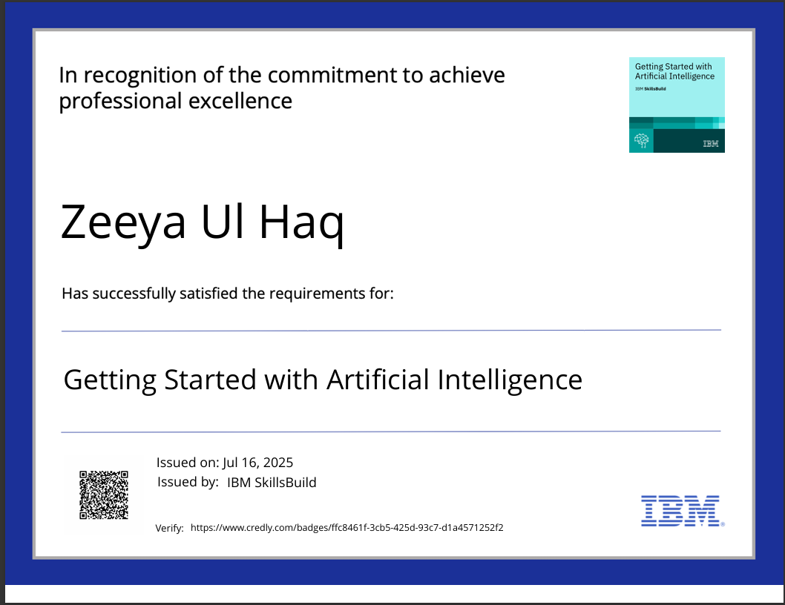
IBM Certifications

Slide 15
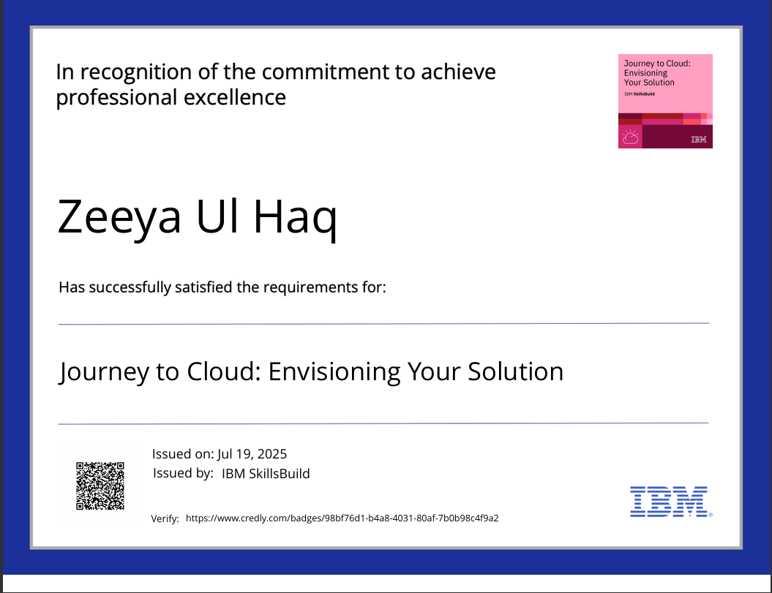
IBM Certifications

Slide 16
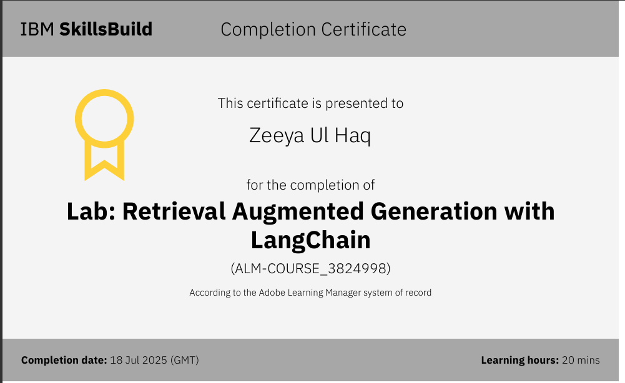
IBM Certifications

Slide 17
GitHub Link
Git hub link : https://github.com/Zeeya-ul-haq/Farming-AI_Agent

Slide 18
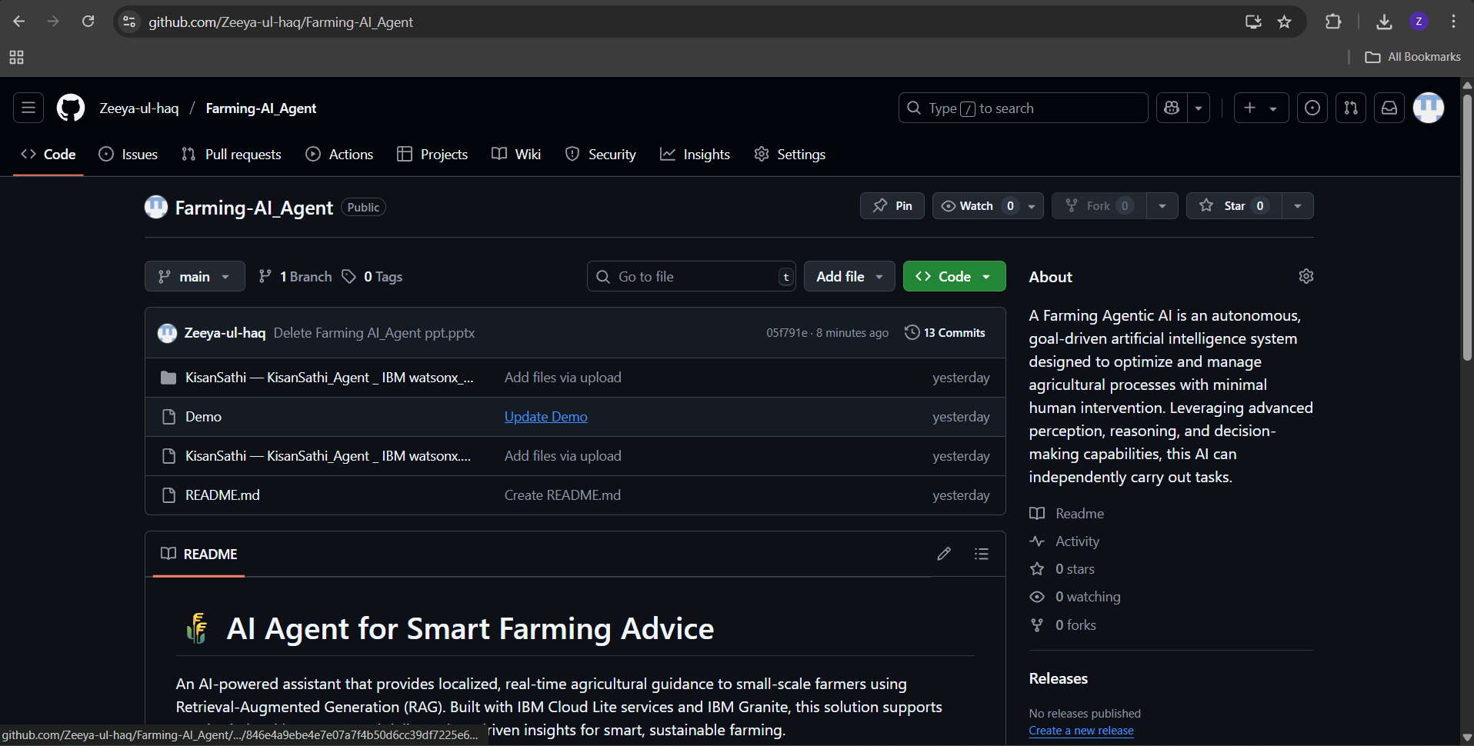
GitHub PTROFILE

Slide 19
THANK YOU

